Slide 1
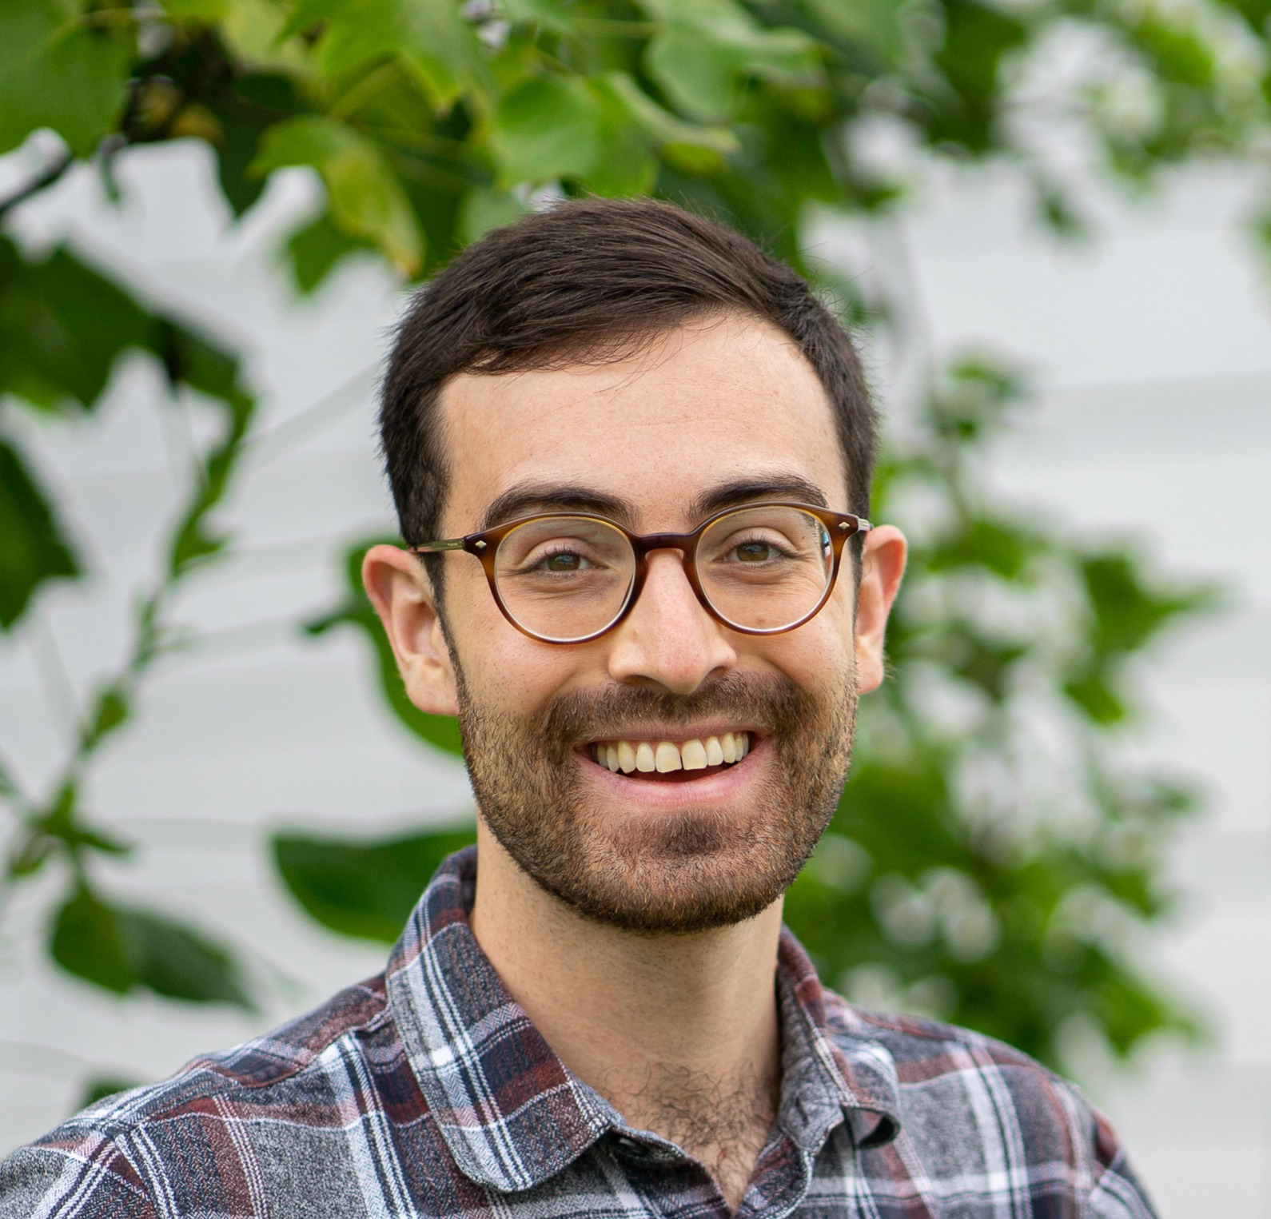
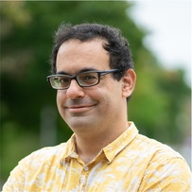
Into the Unknown: Assigning Reviewers to Papers with Uncertain Affinities
Cyrus Cousins
Justin Payan
Yair Zick

Slide 2
Peer Review
Papers must be reviewed by suitable reviewers

Slide 3
Reviewer Assignment Problem
Given affinity scores
Paper Requirements:
Reviewer Load Bounds:
Conflicts of interest:
$$2$$
$$≤2$$
$$5$$
$$4$$
$$8$$
$$4$$
$$2$$
$$≤3$$
$$9$$
$$6$$
$$1$$
$$8$$
$$3$$
$$≤1$$
$$3$$
$$4$$
$$6$$
$$7$$
$$≤2$$
Goal:
Allocation of reviewers to papers with high affinity

Slide 4
What are affinity scores?
For given reviewer-paper pair
the affinity score measures:
$$5$$
Reviewer
interest
Reviewer
expertise
As proxies for:
Predicted review quality

Slide 5
What are affinity scores?
For given reviewer-paper pair
the affinity score measures:
$$5$$
Reviewer
interest
Reviewer
expertise
Hard to measure/predict
As proxies for:
Predicted review quality

Slide 6
Reviewer Assignment Under Uncertainty (RAU)
Compute an uncertainty set $𝒮$
s.t. true, unknown affinity scores $S$ are contained in $𝒮$ with prob. $1−δ$
$$5$$
$$4$$
$$8$$
$$4$$
$$S$$
$$9$$
$$6$$
$$1$$
$$8$$
$$3$$
$$4$$
$$6$$
$$7$$

Slide 7
Reviewer Assignment Under Uncertainty (RAU)
Compute an uncertainty set $𝒮$
s.t. true, unknown affinity scores $S$ are contained in $𝒮$ with prob. $1−δ$
$$≅$$
$$5$$
$$≅$$
$$4$$
$$≅$$
$$8$$
$$≅$$
$$4$$
$$𝒮$$
$$≅$$
$$9$$
$$≅$$
$$6$$
$$≅$$
$$1$$
$$≅$$
$$8$$
$$≅$$
$$3$$
$$≅$$
$$4$$
$$≅$$
$$6$$
$$≅$$
$$7$$

Slide 8
Reviewer Assignment Under Uncertainty (RAU)
Compute an uncertainty set $𝒮$
s.t. true, unknown affinity scores $S$ are contained in $𝒮$ with prob. $1−δ$
$$≅$$
$$5$$
$$≅$$
$$4$$
$$≅$$
$$8$$
$$≅$$
$$4$$
$$𝒮$$
$$≅$$
$$9$$
$$≅$$
$$6$$
$$≅$$
$$1$$
$$≅$$
$$8$$
$$≅$$
$$3$$
$$≅$$
$$4$$
$$≅$$
$$6$$
$$≅$$
$$7$$
Maximize the worst-case welfare over the uncertainty set

Slide 9
Reviewer Assignment Under Uncertainty (RAU)
Papers $P$ and reviewers $R$
Valid assignments $𝒜⊆{\left\{0, 1\right\}}^{\left|P\right|×\left|R\right|}$
Affinity score uncertainty set $𝒮⊆ℝ_{+}^{\left|P\right|×|R|}$
$$A$$
$$USW\left(A,S\right)= \frac{1}{|P|}\sum_{p∈P}{\sum_{r∈R}{A_{pr}S_{pr}}}$$
Objective: $\max_{A∈𝒜}{\min_{S∈𝒮}{USW(A, S)}}$
$$𝒮$$
$$S$$

Slide 10
Reviewer Assignment Under Uncertainty (RAU)
Papers $P$ and reviewers $R$
Valid assignments $𝒜⊆{\left\{0, 1\right\}}^{\left|P\right|×\left|R\right|}$
Affinity score uncertainty set $𝒮⊆ℝ_{+}^{\left|P\right|×|R|}$
$$A$$
$$USW\left(A,S\right)= \frac{1}{|P|}\sum_{p∈P}{\sum_{r∈R}{A_{pr}S_{pr}}}$$
Objective: $\max_{A∈𝒜}{\min_{S∈𝒮}{USW(A, S)}}$
$$𝒮$$
$$S$$

Slide 11
Why Maximin?

Slide 12
Why Maximin?
May not always know expected affinities
Theory and experiments show maximin
corresponds to true welfare

Slide 13
Implementing RAU

Slide 14
Implementing RAU: Bid Prediction
$$9$$
$$9$$
$$9$$
$$≅$$
$$4$$
$$9$$
$$≅$$
$$4$$
$$𝒮$$
$$9$$
$$9$$
$$≅$$
$$9$$
$$9$$
$$9$$
$$≅$$
$$8$$
$$0$$
$$9$$
$$0$$
$$≅$$
$$4$$
$$≅$$
$$6$$
$$9$$
Collaborative Filtering with
Average Error Guarantees
Solicit bids

Slide 15
Implementing RAU: Review Quality Prediction
$$f\left( , \right)=9$$
$$≅$$
$$5$$
$$≅$$
$$4$$
$$≅$$
$$8$$
$$≅$$
$$4$$
$$9$$
$$5$$
$$f\left( , \right)=6$$
$$≅$$
$$9$$
$$≅$$
$$6$$
$$≅$$
$$1$$
$$≅$$
$$8$$
$$9$$
$$3$$
$$f\left( , \right)=8$$
$$≅$$
$$3$$
$$≅$$
$$4$$
$$≅$$
$$6$$
$$≅$$
$$7$$
Label past
assignments
Learn function from
reviewer and
paper features
to affinities
Apply $f$ with
error bounds

Slide 16
Uncertainty
Set

Slide 17
Uncertainty
Set
$$𝒮$$
$$𝒮$$
Transductive Predictors
(CF on Bids)
Inductive Predictors
(Learned $f$ from Data)
$${𝒮=\{S:\left(S−\hat{S}\right)}^{T}Σ^{−1}(S−\hat{S})/nm≤\hat{ξ}+η_{t}\}$$
$${𝒮=\{S:\left(S−\hat{S}\right)}^{T}Σ^{−1}(S−\hat{S})/nm≤\hat{ξ}+η_{i}\}$$

Slide 18
Uncertainty
Set
$$𝒮$$
$$𝒮$$
Transductive Predictors
(CF on Bids)
Inductive Predictors
(Learned $f$ from Data)
$${𝒮=\{S:\left(S−\hat{S}\right)}^{T}Σ^{−1}(S−\hat{S})/nm≤\hat{ξ}+η_{t}\}$$
$${𝒮=\{S:\left(S−\hat{S}\right)}^{T}Σ^{−1}(S−\hat{S})/nm≤\hat{ξ}+η_{i}\}$$
Intersecting Uncertainty Sets
Expanding Uncertainty Sets
$$p\left(S∈𝒮\right)={1−(δ}_{1}+δ_{2})$$

Slide 19
Solving RAU

Slide 20
RAU is NP-hard
Theorem 1:
RAU is NP-hard for convex uncertainty sets $𝒮$

Slide 21
RAU is NP-hard
Theorem 1:
RAU is NP-hard for convex uncertainty sets $𝒮$
Nonlinear objective
$$\max_{A∈𝒜}{\min_{S∈𝒮}{USW(A,S)}}$$

Slide 22
Robust Reviewer Assignment (RRA)
Relax discrete allocations → continuous
$𝒜⊆{\left\{0, 1\right\}}^{m×n}$ → $\tilde{𝒜}⊆{\left[0, 1\right]}^{m×n}$
Solve $\max_{A∈\tilde{𝒜}}{\min_{S∈𝒮}USW(A,S)}$
by stepping in $∂_{A}\min_{S∈𝒮}USW(A,S)$
and projecting back to $\tilde{𝒜}$
Projected subgradient-ascent optimization
Randomized rounding for discrete solution
Round $A∈\tilde{𝒜}$ to $A^{′}∈𝒜$

Slide 23
RRA Guarantees
Define
$\tilde{A}$: the continuous maximin solution
$A′$: the rounding of $\tilde{A}$
$S^{∗}$: the true affinity score matrix
$A^{∗}$: the true optimal allocation
$L$: $ℒ_{1}$-diameter of $𝒮$
$δ$: ${ℙ(S}^{∗}∈𝒮)≥1−δ$

Slide 24
RRA Guarantees
Integrality Gap
Define
$\tilde{A}$: the continuous maximin solution
$A′$: the rounding of $\tilde{A}$
$S^{∗}$: the true affinity score matrix
$A^{∗}$: the true optimal allocation
$L$: $ℒ_{1}$-diameter of $𝒮$
$δ$: ${ℙ(S}^{∗}∈𝒮)≥1−δ$
$$𝔼_{A′}{\left\|A^{′}−\tilde{A}\right\|}_{1}=2{\left({\left\|A^{′}\right\|}_{1}−{\left\|\tilde{A}\right\|}_{1}\right)}_{}$$
$$=\left|P\right|\left|R\right|−2{\left\|\frac{1}{2}−\tilde{A}\right\|}_{1}$$

Slide 25
RRA Guarantees
Integrality Gap
Define
$\tilde{A}$: the continuous maximin solution
$A′$: the rounding of $\tilde{A}$
$S^{∗}$: the true affinity score matrix
$A^{∗}$: the true optimal allocation
$L$: $ℒ_{1}$-diameter of $𝒮$
$δ$: ${ℙ(S}^{∗}∈𝒮)≥1−δ$
$$𝔼_{A′}{\left\|A^{′}−\tilde{A}\right\|}_{1}=2{\left({\left\|A^{′}\right\|}_{1}−{\left\|\tilde{A}\right\|}_{1}\right)}_{}$$
$$=\left|P\right|\left|R\right|−2{\left\|\frac{1}{2}−\tilde{A}\right\|}_{1}$$
True Welfare Gap
$$ℙ\left(USW\left(A^{∗}, S^{∗}\right)−𝔼_{A^{′}}USW\left(A^{′}, S^{∗}\right)>\frac{L}{\left|P\right|}\right)<δ$$

Slide 26
RRA Guarantees
Integrality Gap
We may have to round heavily…
But the maximin objective still ensures high true welfare!
Define
$\tilde{A}$: the continuous maximin solution
$A′$: the rounding of $\tilde{A}$
$S^{∗}$: the true affinity score matrix
$A^{∗}$: the true optimal allocation
$L$: $ℒ_{1}$-diameter of $𝒮$
$δ$: ${ℙ(S}^{∗}∈𝒮)≥1−δ$
$$𝔼_{A′}{\left\|A^{′}−\tilde{A}\right\|}_{1}=2{\left({\left\|A^{′}\right\|}_{1}−{\left\|\tilde{A}\right\|}_{1}\right)}_{}$$
$$=\left|P\right|\left|R\right|−2{\left\|\frac{1}{2}−\tilde{A}\right\|}_{1}$$
True Welfare Gap
$$ℙ\left(USW\left(A^{∗}, S^{∗}\right)−𝔼_{A^{′}}USW\left(A^{′}, S^{∗}\right)>\frac{L}{\left|P\right|}\right)<δ$$

Slide 27
ICLR Experiments
$100∗$Adversarial
USW
$100∗$Average
USW
Year | # Revs | # Papers | ILP | RRA | ILP | RRA
$$2018$$ | $$1657$$ | $$546$$ | $$17$$ | $$16$$ | $$179$$ | $1$60
$$2019$$ | $$2620$$ | $$851$$ | $$22$$ | $$27$$ | $$184$$ | $$161$$
$$2020$$ | $$4123$$ | $$1327$$ | $$17$$ | $$23$$ | $$187$$ | $$166$$
$$2021$$ | $$4662$$ | $$1557$$ | $$23$$ | $$33$$ | $$192$$ | $$174$$
$$2022$$ | $$5023$$ | $$1576$$ | $$28$$ | $$38$$ | $$191$$ | $$172$$
 | Average |  | $$21.4$$ | $$27.4$$ $$(+28\%)$$ | $$187$$ | $$167$$ $$(−11\%)$$
USW numbers are divided by # Papers

Slide 28
ICLR Experiments
$100∗$Adversarial
USW
$100∗$Average
USW
Year | # Revs | # Papers | ILP | RRA | ILP | RRA
$$2018$$ | $$1657$$ | $$546$$ | $$17$$ | $$16$$ | $$179$$ | $1$60
$$2019$$ | $$2620$$ | $$851$$ | $$22$$ | $$27$$ | $$184$$ | $$161$$
$$2020$$ | $$4123$$ | $$1327$$ | $$17$$ | $$23$$ | $$187$$ | $$166$$
$$2021$$ | $$4662$$ | $$1557$$ | $$23$$ | $$33$$ | $$192$$ | $$174$$
$$2022$$ | $$5023$$ | $$1576$$ | $$28$$ | $$38$$ | $$191$$ | $$172$$
 | Average |  | $$21.4$$ | $$27.4$$ $$(+28\%)$$ | $$187$$ | $$167$$ $$(−11\%)$$
USW numbers are divided by # Papers

Slide 29
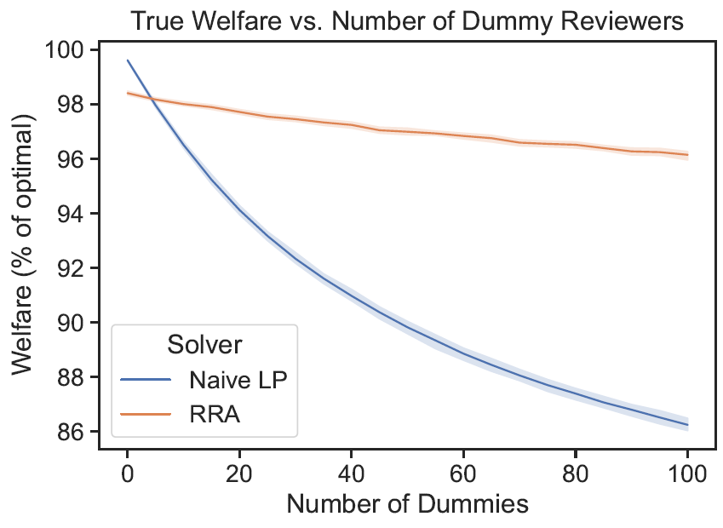
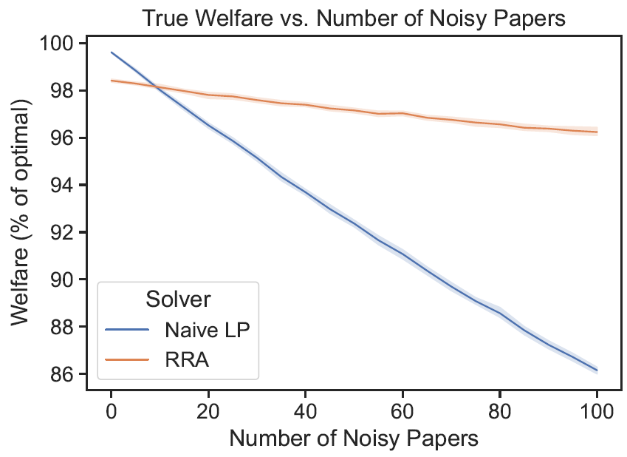
True Welfare under Noise

Slide 30
https://t.ly/g_sLd

Slide 31
Thanks!
Email: jpayan@cs.umass.edu

Slide 35
Robust Reviewer Assignment (RRA)
What about general convex uncertainty sets $𝒮$?
Relax, then apply projected subgradient ascent against an “adversary”

Slide 36
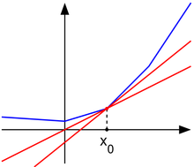
Robust Reviewer Assignment (RRA)
What about general convex uncertainty sets $𝒮$?
Relax, then apply projected subgradient ascent against an “adversary”
Gradient ascent for
non-differentiable functions

Slide 37
Robust Reviewer Assignment (RRA)
What about general convex uncertainty sets $𝒮$?
Relax, then apply projected subgradient ascent against an “adversary”
At each step, ensure
constraints are satisfied
Gradient ascent for
non-differentiable functions

Slide 38
Robust Reviewer Assignment (RRA)
What about general convex uncertainty sets $𝒮$?
Relax, then apply projected subgradient ascent against an “adversary”
At each step, ensure
constraints are satisfied
Gradient ascent for
non-differentiable functions
It’s a maximin problem

Slide 39
Robust Reviewer Assignment (RRA)
What about general convex uncertainty sets $𝒮$?
Relax, then apply projected subgradient ascent against an “adversary”
Converges in poly-time if projection and adversary are efficient
At each step, ensure
constraints are satisfied
Gradient ascent for
non-differentiable functions
It’s a maximin problem

Slide 40
Robust Reviewer Assignment (RRA)
Randomized rounding for discrete solution
Round $A∈\tilde{𝒜}$ to $A^{′}∈𝒜$

Slide 41
Robust Reviewer Assignment (RRA)
Randomized rounding for discrete solution
Round $A∈\tilde{𝒜}$ to $A^{′}∈𝒜$
Generalization of Birkhoff von Neumann decomposition
Maintains constraints of $\tilde{𝒜}$ and $𝒜$
$$𝔼\left[A^{′}\right]=A$$
$$\min_{S∈𝒮}{USW\left(A^{′}, S\right)≤\min_{S∈𝒮}{USW(A, S)}}$$
Budish et al. Implementing random assignments: A generalization of the birkhoff-von neumann theorem. 2009.
Jecmen et al. Mitigating manipulation in peer review via randomized reviewer assignments. 2020.

Slide 42
ICLR Experiments

Slide 43
Robust Reviewer Assignment (RRA)
What about general convex uncertainty sets $𝒮$?
Relax, then apply projected subgradient ascent against an “adversary”

Slide 44
Simple Uncertainty Sets
Independent
Bounding Boxes
$$𝒮$$

Slide 45
Simple Uncertainty Sets
Independent
Bounding Boxes
$$𝒮$$
$$\underline{S}$$
Optimize assuming $\underline{S}$

Slide 46
Simple Uncertainty Sets
Independent
Bounding Boxes
Sphere
$$𝒮=ℬ_{ε}(S_{0})$$
$$𝒮$$
$$S_{0}$$
$$\underline{S}$$
Optimize assuming $\underline{S}$

Slide 47
Simple Uncertainty Sets
Independent
Bounding Boxes
Sphere
$$𝒮=ℬ_{ε}(S_{0})$$
$$𝒮$$
$$S_{0}$$
$$\underline{S}$$
Optimize assuming $\underline{S}$
Optimize assuming $S_{0}$

Slide 48
Compute affinity scores
Maximize function of affinity scores
Collect constraints
Collect data
Adjust assignment

Slide 49
Compute affinity scores
Maximize function of affinity scores
Collect constraints
Collect data
Adjust assignment
Compute $𝒮$ as a $τ\%$ CI of $𝒩(μ, Σ)$
$$𝒮$$
$μ$ is the base scores
$$μ$$
$Σ$ is diagonal, based on number of missing sources

Slide 50
Extensions
(and Related Problems)

Slide 51
Learning Bids
Reviewer bid
Document similarity
Keyword matching
$$1$$
$$7$$
$$4$$
$$λ_{1}$$
$$1$$
$$+$$
$$λ_{2}$$
$$7$$
$$+$$
$$λ_{3}$$
$$4$$
$$1$$
$$7$$
$$4$$
Bids solicited according to distribution $𝒟$
Fill in $?$ with $L_{2}$-error guarantees over $𝒟$
$$𝒮$$
$$5$$
$$?$$
$$?$$
$$4$$
$$?$$
$$6$$
$$?$$
$$8$$

Slide 52
Assign for Predicted Quality
Predict important review aspects
Value of assigning
reviewer set $C$ to paper $p$ is
$$λ_{1}\sum_{r∈C}{d_{rp}}+λ_{2}\sum_{i}{\max_{r∈C}{p(a_{i}|r,p)}}$$
Agreement with final decision $(d)$
-1
0
+1
Probability of covering aspects $(p\left(a_{i}\right))$
Constrained allocation of indivisible resources with submodular valuations
Soundness
Clarity
Reproducibility

Slide 53
Online Reviewer Assignment
$m$ reviewers available, must review $n_{t}$ papers in month $t$
$$m$$
$$m$$
$$m$$
$$n_{1}$$
$$S^{(1)}$$
$$n_{2}$$
$$S^{(2)}$$
$$…$$
$$n_{T}$$
$$S^{(T)}$$
$$\sum_{t}{\sum_{p}{A_{pr}^{(t)}}≤U_{r} }$$
$$\max_{A^{(1)}, A^{(2)},…A^{(T)}}{\sum_{t}{USW(A^{\left(t\right)},S^{(t)})}}$$
for all $r$
Goal:
subj. to
$$\sum_{p}{A_{pr}^{(t)}≤U_{r}^{(t)} }$$
for all $r,t$

Slide 54
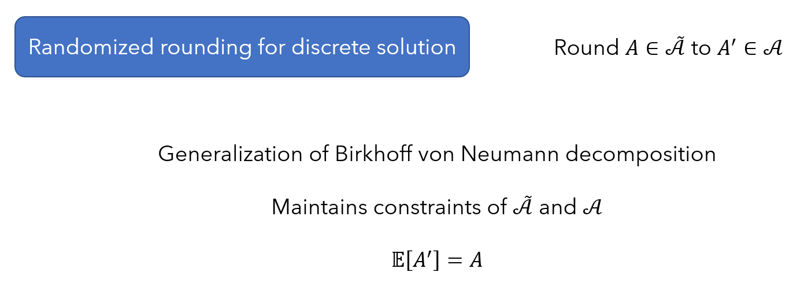
Improving RRA
Precise trade-offs in randomized rounding with constraints
Can replace this with guarantees on USW?

Slide 55
Uncertainty: Nowhere to be Found
Cannot trust high affinity scores
Low scores are too pessimistic (esp. with missing data)

Slide 56
Outline
Step through a typical conference workflow
Introduce RRA, a framework that accounts for uncertainty
Also allows us to use new affinity score estimation methods

Slide 57
Robust Reviewer Assignment (RRA)
Compute an uncertainty set $𝒮$ containing true, unknown affinity scores $S$

Slide 58
Robust Reviewer Assignment (RRA)
Compute an uncertainty set $𝒮$ containing true, unknown affinity scores $S$
$$5$$
$$4$$
$$8$$
$$4$$
$$9$$
$$6$$
$$1$$
$$8$$
$$S$$
$$3$$
$$4$$
$$6$$
$$7$$

Slide 59
What is RAU, really?

Slide 60
What is RAU, really?
$$A$$
Maximin USW is a lower bound for true USW
$$𝒮$$
Flexibly trades off between
certainty and high expected value
$$S$$
$$\max_{A∈𝒜}{\min_{S∈𝒮}{USW(A,S)}}$$
Approaches original problem as $𝒮→S$

Slide 61
Outline
Step through a typical conference workflow
Introduce RRA, a framework that accounts for uncertainty
Also allows us to use new affinity score estimation methods

Slide 62
Conference Workflow 1.0
Compute affinity scores
Maximize function of affinity scores
Collect constraints
Collect data
Adjust assignment

Slide 63
Conference Workflow 1.0
Compute affinity scores
Maximize function of affinity scores
Collect constraints
Collect data
Adjust assignment
Kobren et al. Paper matching with local fairness constraints. 2019.
Stelmakh et al. PeerReview4All: Fair and accurate reviewer assignment in peer review. 2019.
Leyton-Brown et al. Matching papers and reviewers at large conferences. 2022.
Charlin and Zemel. The Toronto paper matching system: an automated paper-reviewer assignment system. 2013

Slide 64
Compute affinity scores
Maximize function of affinity scores
Collect constraints
Collect data
Adjust assignment

Slide 65
Compute affinity scores
Maximize function of affinity scores
Collect constraints
Collect data
Adjust assignment
Affinity scores
Reviewer bid
Document similarity
Keyword matching
$$5$$
$$4$$
$$8$$
$$4$$
$$=$$
$$1$$
$$+$$
$$7$$
$$+$$
$$4$$
$$9$$
$$6$$
$$1$$
$$8$$
$$1$$
$$7$$
$$4$$
$$3$$
$$4$$
$$6$$
$$7$$

Slide 66
Compute affinity scores
Maximize function of affinity scores
Collect constraints
Collect data
Adjust assignment
Affinity scores
Reviewer bid
Document similarity
Keyword matching
$$5$$
$$4$$
$$8$$
$$4$$
$$=$$
$$?$$
$$+$$
$$7$$
$$+$$
$$4$$
$$9$$
$$6$$
$$1$$
$$8$$
$$1$$
Bids often missing!
$$3$$
$$4$$
$$6$$
$$7$$

Slide 67
Compute affinity scores
Maximize function of affinity scores
Collect constraints
Collect data
Adjust assignment
Affinity scores
Reviewer bid
Document similarity
Keyword matching
$$5$$
$$4$$
$$8$$
$$4$$
$$=$$
$$?$$
$$+$$
$$7$$
$$+$$
$$4$$
$$9$$
$$6$$
$$1$$
$$8$$
$$1$$
$$7$$
$$4$$
$$4$$
Bids often missing!
$$3$$
$$4$$
$$6$$
$$7$$

Slide 68
Compute affinity scores
Maximize function of affinity scores
Collect constraints
Collect data
Adjust assignment
Affinity scores
Reviewer bid
Document similarity
Keyword matching
$$5$$
$$4$$
$$8$$
$$4$$
$$=$$
$$?$$
$$+$$
$$7$$
$$+$$
$$4$$
$$9$$
$$6$$
$$1$$
$$8$$
$$1$$
Bids often missing!
$$3$$
$$4$$
$$6$$
$$7$$

Slide 69
Compute affinity scores
Maximize function of affinity scores
Collect constraints
Collect data
Adjust assignment
Affinity scores
Reviewer bid
Document similarity
Keyword matching
$$5$$
$$4$$
$$8$$
$$4$$
$$=$$
$$?$$
$$+$$
$$?$$
$$+$$
$$4$$
$$9$$
$$6$$
$$1$$
$$8$$
$$1$$
$$7$$
$$4$$
Bids often missing!
Error from ML models
$$3$$
$$4$$
$$6$$
$$7$$

Slide 70
Compute affinity scores
Maximize function of affinity scores
Collect constraints
Collect data
Adjust assignment
Affinity scores
Reviewer bid
Document similarity
Keyword matching
$$5$$
$$4$$
$$8$$
$$4$$
$$=$$
$$?$$
$$+$$
$$?$$
$$+$$
$$?$$
$$9$$
$$6$$
$$1$$
$$8$$
$$1$$
$$7$$
$$4$$
Bids often missing!
Error from ML models
Vocab mismatch
$$3$$
$$4$$
$$6$$
$$7$$

Slide 71
Compute affinity scores
Maximize function of affinity scores
Collect constraints
Collect data
Adjust assignment
Affinity scores
Reviewer bid
Document similarity
Keyword matching
$$5$$
$$4$$
$$8$$
$$4$$
$$=$$
$$?$$
$$+$$
$$?$$
$$+$$
$$?$$
$$9$$
$$6$$
$$1$$
$$8$$
$$1$$
$$7$$
$$4$$
Bids often missing!
Error from ML models
Vocab mismatch
$$3$$
$$4$$
$$6$$
$$7$$
All just proxies!

Slide 72
Compute affinity scores
Maximize function of affinity scores
Collect constraints
Collect data
Adjust assignment

Slide 73
Compute affinity scores
Maximize function of affinity scores
Collect constraints
Collect data
Adjust assignment
Affinity scores
Reviewer bid
Document similarity
Keyword matching
$$5$$
$$4$$
$$8$$
$$4$$
$$=$$
$$1$$
$$+$$
$$7$$
$$+$$
$$4$$
$$9$$
$$6$$
$$1$$
$$8$$
$$1$$
$$7$$
$$4$$
$$3$$
$$4$$
$$6$$
$$7$$

Slide 74
Compute affinity scores
Maximize function of affinity scores
Collect constraints
Collect data
Adjust assignment
Reviewer bid
Document similarity
Keyword matching
$$1$$
$$7$$
$$4$$
$$4$$
$$=$$
$$λ_{1}$$
$$1$$
$$+$$
$$λ_{2}$$
$$7$$
$$+$$
$$λ_{3}$$
$$4$$
$$1$$
$$7$$
$$4$$
$$1$$
$$7$$
$$4$$

Slide 75
Compute affinity scores
Maximize function of affinity scores
Collect constraints
Collect data
Adjust assignment
Reviewer bid
Document similarity
Keyword matching
$$1$$
$$7$$
$$4$$
$$4$$
$$=$$
$$λ_{1}$$
$$1$$
$$+$$
$$λ_{2}$$
$$7$$
$$+$$
$$λ_{3}$$
$$4$$
$$1$$
$$7$$
$$4$$
$$1$$
$$7$$
$$4$$
Any unavailable data is set to $0$
Underestimation means high affinity scores are high with certainty

Slide 76
Compute affinity scores
Maximize function of affinity scores
Collect constraints
Collect data
Adjust assignment
Papers $P$ and reviewers $R$
Valid assignments $𝒜⊆{\left\{0, 1\right\}}^{\left|P\right|×\left|R\right|}$
Affinity score matrix $S∈ℝ_{+}^{\left|P\right|×|R|}$
Given affinity scores
$$5$$
$$4$$
$$8$$
$$4$$
Maximize Utilitarian Social Welfare
$$\max_{A∈𝒜}\left[\sum_{p∈P, r∈R}{A_{pr}S_{pr}}=USW(A,S)\right]$$
$$9$$
$$6$$
$$1$$
$$8$$
$$3$$
$$4$$
$$6$$
$$7$$

Slide 77
Compute affinity scores
Maximize function of affinity scores
Collect constraints
Collect data
Adjust assignment
Papers $P$ and reviewers $R$
Valid assignments $𝒜⊆{\left\{0, 1\right\}}^{\left|P\right|×\left|R\right|}$
Affinity score matrix $S∈ℝ_{+}^{\left|P\right|×|R|}$
Given affinity scores
$$5$$
$$4$$
$$8$$
$$4$$
Maximize Utilitarian Social Welfare
$$\max_{A∈𝒜}\left[\sum_{p∈P, r∈R}{A_{pr}S_{pr}}=USW(A,S)\right]$$
$$9$$
$$6$$
$$1$$
$$8$$
$$3$$
$$4$$
$$6$$
$$7$$
ILP with totally unimodular constraints
(poly-time solvable)
Taylor. On the optimal assignment of conference papers to reviewers. 2008.

Slide 78
Robust Reviewer Assignment (RRA)
Compute an uncertainty set $𝒮$ containing true, unknown affinity scores $S$
$$5$$
$$4$$
$$8$$
$$4$$
$$S$$
$$𝒮$$
$$9$$
$$6$$
$$1$$
$$8$$
$$3$$
$$4$$
$$6$$
$$7$$
Maximize the worst-case welfare over the uncertainty set

Slide 79
Robust Reviewer Assignment (RRA)
Compute an uncertainty set $𝒮$ containing true, unknown affinity scores $S$
$$5$$
$$4$$
$$8$$
$$4$$
$$S$$
$$𝒮$$
$$9$$
$$6$$
$$1$$
$$8$$
$$3$$
$$4$$
$$6$$
$$7$$
Maximize the worst-case welfare over the uncertainty set

Slide 80
ICLR Experiments
Got all submitted papers to last 5 years of ICLR
Used authors as “reviewers”
Keywords = paper topics and author expertise

Slide 81
ICLR Experiments
Got all submitted papers to last 5 years of ICLR
Used authors as “reviewers”
Keywords = paper topics and author expertise
Compute $𝒮$ as a contour of $𝒩(μ, Σ)$
$$𝒮$$
$μ$ based on keyword overlap
$$μ$$
$diag(Σ)∝$ 1/(# keywords)

Slide 82
Robust Reviewer Assignment (RRA)
Relax discrete -> continuous
Subgradient-ascent optimization
Randomized rounding for discrete solution

Slide 83
Robust Reviewer Assignment (RRA)
Relax discrete -> continuous
$𝒜⊆{\left\{0, 1\right\}}^{m×n}$ → $\tilde{𝒜}⊆{\left[0, 1\right]}^{m×n}$
Subgradient-ascent optimization
Randomized rounding for discrete solution

Slide 84
Robust Reviewer Assignment (RRA)
Relax discrete -> continuous
$𝒜⊆{\left\{0, 1\right\}}^{m×n}$ → $\tilde{𝒜}⊆{\left[0, 1\right]}^{m×n}$
Subgradient-ascent optimization
Solve $\max_{A∈\tilde{𝒜}}{f(A)}$ by steps in $∂_{A}f(A)$
Randomized rounding for discrete solution

Slide 85
Robust Reviewer Assignment (RRA)
Subgradient-ascent optimization
Solve $\max_{A∈\tilde{𝒜}}{f(A)}$ by steps in $∂_{A}f(A)$

Slide 86
Robust Reviewer Assignment (RRA)
Subgradient-ascent optimization
Solve $\max_{A∈\tilde{𝒜}}{f(A)}$ by steps in $∂_{A}f(A)$

Slide 87
Robust Reviewer Assignment (RRA)
Subgradient-ascent optimization
Solve $\max_{A∈\tilde{𝒜}}{f(A)}$ by steps in $∂_{A}f(A)$
Compute $f(A)$ as the adversary
Step in direction of $∂_{A}f(A)$
$T$ iterations
Project to feasible set $\tilde{𝒜}$

Slide 88
Robust Reviewer Assignment (RRA)
Subgradient-ascent optimization
Solve $\max_{A∈\tilde{𝒜}}{f(A)}$ by steps in $∂_{A}f(A)$
Compute $f(A)$ as the adversary
$$f(A)=\min_{S∈𝒮}{USW(A,S)}$$
Step in direction of $∂_{A}f(A)$
$T$ iterations
Project to feasible set $\tilde{𝒜}$

Slide 89
Robust Reviewer Assignment (RRA)
Subgradient-ascent optimization
Solve $\max_{A∈\tilde{𝒜}}{f(A)}$ by steps in $∂_{A}f(A)$
Compute $f(A)$ as the adversary
$$f(A)=\min_{S∈𝒮}{USW(A,S)}$$
$${∇_{A}USW(A,\underset{S∈𝒮}{argmin}{USW(A,S))}∈∂}_{A}f\left(A\right)$$
$$A^{′}←A+∇_{A}USW(A,\underset{S∈𝒮}{argmin}{USW(A,S))}$$
Step in direction of $∂_{A}f(A)$
$T$ iterations
Project to feasible set $\tilde{𝒜}$

Slide 90
Robust Reviewer Assignment (RRA)
Subgradient-ascent optimization
Solve $\max_{A∈\tilde{𝒜}}{f(A)}$ by steps in $∂_{A}f(A)$
Compute $f(A)$ as the adversary
$$f(A)=\min_{S∈𝒮}{USW(A,S)}$$
$${∇_{A}USW(A,\underset{S∈𝒮}{argmin}{USW(A,S))}∈∂}_{A}f\left(A\right)$$
$$A^{′}←A+∇_{A}USW(A,\underset{S∈𝒮}{argmin}{USW(A,S))}$$
Step in direction of $∂_{A}f(A)$
$T$ iterations
Project to feasible set $\tilde{𝒜}$
$$A^{′′}←\underset{A∈\tilde{𝒜}}{argmin}{\left\|A−A^{′}\right\|}_{2}$$

Slide 91
Robust Reviewer Assignment (RRA)
Relax discrete -> continuous
$𝒜⊆{\left\{0, 1\right\}}^{m×n}$ → $\tilde{𝒜}⊆{\left[0, 1\right]}^{m×n}$
Subgradient-ascent optimization
Solve $\max_{A∈\tilde{𝒜}}{f(A)}$ by steps in $∂_{A}f(A)$
Randomized rounding for discrete solution
Round $A∈\tilde{𝒜}$ to $A^{′}∈𝒜$

Slide 92
Spherical Uncertainty Sets
Theorem 2:
$$\max_{A∈𝒜}{\min_{S∈ℬ_{ε}(S_{0})}{USW(A,S)}}=\max_{A∈𝒜}{USW(A,S_{0})}$$
Proof sketch:
$$\min_{S∈ℬ_{ε}(S_{0})}{USW(A,S)}=\min_{X∈ℬ_{ε}\left(0\right)}USW\left(A, S_{0}+X\right)$$

Slide 93
Spherical Uncertainty Sets
Theorem 2:
$$\max_{A∈𝒜}{\min_{S∈ℬ_{ε}(S_{0})}{USW(A,S)}}=\max_{A∈𝒜}{USW(A,S_{0})}$$
Proof sketch:
$$\min_{S∈ℬ_{ε}(S_{0})}{USW(A,S)}=\min_{X∈ℬ_{ε}\left(0\right)}USW\left(A, S_{0}+X\right)$$
$$=USW\left(A, S_{0}\right)+\min_{X∈ℬ_{ε}\left(0\right)}USW\left(A, X\right)$$

Slide 94
Spherical Uncertainty Sets
Theorem 2:
$$\max_{A∈𝒜}{\min_{S∈ℬ_{ε}(S_{0})}{USW(A,S)}}=\max_{A∈𝒜}{USW(A,S_{0})}$$
Proof sketch:
$$\min_{S∈ℬ_{ε}(S_{0})}{USW(A,S)}=\min_{X∈ℬ_{ε}\left(0\right)}USW\left(A, S_{0}+X\right)$$
Minimized when $X$ points as far in the direction opposite $A$ as possible:
$$X=−A\frac{ε}{{\left\|A\right\|}_{2}}$$
$$=USW\left(A, S_{0}\right)+\min_{X∈ℬ_{ε}\left(0\right)}USW\left(A, X\right)$$

Slide 95
Spherical Uncertainty Sets
Theorem 2:
$$\max_{A∈𝒜}{\min_{S∈ℬ_{ε}(S_{0})}{USW(A,S)}}=\max_{A∈𝒜}{USW(A,S_{0})}$$
Proof sketch:
$$\min_{S∈ℬ_{ε}(S_{0})}{USW(A,S)}=\min_{X∈ℬ_{ε}\left(0\right)}USW\left(A, S_{0}+X\right)$$
Minimized when $X$ points as far in the direction opposite $A$ as possible:
$$X=−A\frac{ε}{{\left\|A\right\|}_{2}}$$
$$=USW\left(A, S_{0}\right)+\min_{X∈ℬ_{ε}\left(0\right)}USW\left(A, X\right)$$
$$=USW\left(A, S_{0}\right)+USW\left(A, −A\frac{ε}{{\left\|A\right\|}_{2}}\right)$$

Slide 96
Spherical Uncertainty Sets
Theorem 2:
$$\max_{A∈𝒜}{\min_{S∈ℬ_{ε}(S_{0})}{USW(A,S)}}=\max_{A∈𝒜}{USW(A,S_{0})}$$
Proof sketch:
$$\min_{S∈ℬ_{ε}(S_{0})}{USW(A,S)}=\min_{X∈ℬ_{ε}\left(0\right)}USW\left(A, S_{0}+X\right)$$
Minimized when $X$ points as far in the direction opposite $A$ as possible:
$$X=−A\frac{ε}{{\left\|A\right\|}_{2}}$$
$$=USW\left(A, S_{0}\right)+\min_{X∈ℬ_{ε}\left(0\right)}USW\left(A, X\right)$$
$$=USW\left(A, S_{0}\right)+USW\left(A, −A\frac{ε}{{\left\|A\right\|}_{2}}\right)$$
$$=USW\left(A, S_{0}\right)−{\left\|A\right\|}_{2}^{2}\frac{ε}{{\left\|A\right\|}_{2}}$$

Slide 97
Spherical Uncertainty Sets
Theorem 2:
$$\max_{A∈𝒜}{\min_{S∈ℬ_{ε}(S_{0})}{USW(A,S)}}=\max_{A∈𝒜}{USW(A,S_{0})}$$
Proof sketch:
$$\min_{S∈ℬ_{ε}(S_{0})}{USW(A,S)}=\min_{X∈ℬ_{ε}\left(0\right)}USW\left(A, S_{0}+X\right)$$
Minimized when $X$ points as far in the direction opposite $A$ as possible:
$$X=−A\frac{ε}{{\left\|A\right\|}_{2}}$$
$$=USW\left(A, S_{0}\right)+\min_{X∈ℬ_{ε}\left(0\right)}USW\left(A, X\right)$$
$$=USW\left(A, S_{0}\right)+USW\left(A, −A\frac{ε}{{\left\|A\right\|}_{2}}\right)$$
$$=USW\left(A, S_{0}\right)−{\left\|A\right\|}_{2}^{2}\frac{ε}{{\left\|A\right\|}_{2}}$$
$$=USW\left(A, S_{0}\right)−{\left\|A\right\|}_{2}ε$$

Slide 98
Spherical Uncertainty Sets
Theorem 2:
$$\max_{A∈𝒜}{\min_{S∈ℬ_{ε}(S_{0})}{USW(A,S)}}=\max_{A∈𝒜}{USW(A,S_{0})}$$
Proof sketch:
$$\min_{S∈ℬ_{ε}(S_{0})}{USW(A,S)}=\min_{X∈ℬ_{ε}\left(0\right)}USW\left(A, S_{0}+X\right)$$
Minimized when $X$ points as far in the direction opposite $A$ as possible:
$$X=−A\frac{ε}{{\left\|A\right\|}_{2}}$$
$$=USW\left(A, S_{0}\right)+\min_{X∈ℬ_{ε}\left(0\right)}USW\left(A, X\right)$$
$$=USW\left(A, S_{0}\right)+USW\left(A, −A\frac{ε}{{\left\|A\right\|}_{2}}\right)$$
$$=USW\left(A, S_{0}\right)−{\left\|A\right\|}_{2}^{2}\frac{ε}{{\left\|A\right\|}_{2}}$$
Constant, due to constraints
$$=USW\left(A, S_{0}\right)−{\left\|A\right\|}_{2}ε$$

Slide 99
Future Work
Be sure to publicize FairSeq, our recently submitted paper, and the workshop.
Further experiments
Take datasets of affinity scores, drop some and fill in remaining values
Build a predictive model of affinity scores from old conferences
Collect data from conference organizers
Discuss the collaborative filtering bid model?
Combining fairness and robustness
Add an envy penalty to the objective function
Maximize expected egalitarian welfare
Rounding tradeoffs?

Slide 100
Fair Division at IJCAI
Anyone want to co-organize?
Plan to submit papers!
Mention proposed schedule, etc.

Slide 101
Compute affinity scores
Maximize function of affinity scores
Collect constraints
Collect data
Adjust assignment
Affinity scores
Reviewer bid
Document similarity
Keyword matching
$$1$$
$$7$$
$$4$$
$$4$$
$$=$$
$$λ_{1}$$
$$1$$
$$+$$
$$λ_{2}$$
$$7$$
$$+$$
$$λ_{3}$$
$$4$$
$$1$$
$$7$$
$$4$$
$$1$$
$$7$$
$$4$$

Slide 102
Compute affinity scores
Maximize function of affinity scores
Collect constraints
Collect data
Adjust assignment
Affinity scores
Reviewer bid
Document similarity
Keyword matching
$$1$$
$$7$$
$$4$$
$$λ_{2}$$
$$λ_{3}$$
Does this necessarily correlate with review quality?
$$4$$
$$=$$
$$λ_{1}$$
$$1$$
$$+$$
$$7$$
$$+$$
$$4$$
$$1$$
$$7$$
$$4$$
$$1$$
$$7$$
$$4$$

Slide 103
Allocation Deciderata
High affinity (welfare/USW)
Fair to papers
$$>$$
$$>$$
$$9$$
$$0$$
$$9$$
$$0$$
Fast to compute
Adapt to constraints

Slide 104
Allocation Deciderata
High affinity (welfare/USW)
Fair to papers
Robustness to noisy affinities
$$>$$
$$>$$
$$9$$
$$0$$
$$9$$
$$0$$
$$5$$
$$?$$
Fast to compute
$$?$$
$$6$$
Adapt to constraints

Slide 105
Fairness to Papers
Envy-freeness up to $1$ Item (EF$1$)
Ensures pairwise balance in affinity scores
Large literature with simple/fast algorithms

Slide 106
Envy-freeness up to 1 Item (EF1)
For all pairs of papers A and B, if B receives a set of reviewers that is better suited for A, then it is due to at most one reviewer

Slide 107
Envy-freeness up to 1 Item (EF1)
For all pairs of papers A and B, if B receives a set of reviewers that is better suited for A, then it is due to at most one reviewer
$$13$$
$$9$$
$$5$$
$$4$$
$$8$$
$$8$$
$$9$$
$$6$$
$$1$$
$$8$$

Slide 108
Envy-freeness up to 1 Item (EF1)
For all pairs of papers A and B, if B receives a set of reviewers that is better suited for A, then it is due to at most one reviewer
$$5$$
$$13$$
$$9$$
$$5$$
$$4$$
$$8$$
$$8$$
$$9$$
$$6$$
$$1$$
$$8$$

Slide 109
Envy-freeness up to 1 Item (EF1)
For all pairs of papers A and B, if B receives a set of reviewers that is better suited for A, then it is due to at most one reviewer
Does not make sense when papers have variable demands

Slide 110
Weighted EF1 (WEF1)
For all pairs of papers A and B, if B receives a set of reviewers that is better suited for A after adjusting for paper demands, then it is due to at most one reviewer

Slide 111
Weighted EF1 (WEF1)
For all pairs of papers A and B, if B receives a set of reviewers that is better suited for A after adjusting for paper demands, then it is due to at most one reviewer
$$\frac{21}{3}=7$$
$$\frac{9}{2}=4.5$$
$$5$$
$$4$$
$$8$$
$$8$$
$$9$$
$$6$$
$$1$$
$$8$$

Slide 112
Weighted EF1 (WEF1)
For all pairs of papers A and B, if B receives a set of reviewers that is better suited for A after adjusting for paper demands, then it is due to at most one reviewer
$$13$$
$$4.25$$
$$\frac{21}{3}=7$$
$$\frac{9}{2}=4.5$$
$$5$$
$$4$$
$$8$$
$$8$$
$$9$$
$$6$$
$$1$$
$$8$$

Slide 113
Picking Sequences for EF1 and Welfare
Put papers in some order,
and assign reviewers in that order
Choose the order for EF1 & (approximate) max welfare

Slide 114
Picking Sequences for EF1 and Welfare
I Will Have Order! Optimizing Orders for Fair Reviewer Assignment.
Payan and Zick, IJCAI 2022.
Fixed order, repeated over rounds (round-robin order) is EF1
$$…$$
Does not work for
variable paper demands
Finding a high-welfare round-robin order is slow

Slide 115
FairSequence
Picking sequence that assigns in order of fraction of demand satisfied
Ties broken to greedily maximize affinity

Slide 116
FairSequence
Picking sequence that assigns in order of fraction of demand satisfied
Ties broken to greedily maximize affinity
$$0/2$$
$$5$$
$$4$$
$$8$$
$$4$$
$$0/2$$
$$9$$
$$6$$
$$1$$
$$8$$
$$0/3$$
$$3$$
$$4$$
$$6$$
$$7$$

Slide 117
FairSequence
Picking sequence that assigns in order of fraction of demand satisfied
Ties broken to greedily maximize affinity
$$0/2$$
$$5$$
$$4$$
$$8$$
$$4$$
$$1/2$$
$$9$$
$$6$$
$$1$$
$$8$$
$$0/3$$
$$3$$
$$4$$
$$6$$
$$7$$

Slide 118
FairSequence
Picking sequence that assigns in order of fraction of demand satisfied
Ties broken to greedily maximize affinity
$$0/2$$
$$5$$
$$4$$
$$8$$
$$4$$
$$1/2$$
$$9$$
$$6$$
$$1$$
$$8$$
$$0/3$$
$$3$$
$$4$$
$$6$$
$$7$$

Slide 119
FairSequence
Picking sequence that assigns in order of fraction of demand satisfied
Ties broken to greedily maximize affinity
$$1/2$$
$$5$$
$$4$$
$$8$$
$$4$$
$$1/2$$
$$9$$
$$6$$
$$1$$
$$8$$
$$0/3$$
$$3$$
$$4$$
$$6$$
$$7$$

Slide 120
FairSequence
Picking sequence that assigns in order of fraction of demand satisfied
Ties broken to greedily maximize affinity
Very fast
Satisfies WEF1
$$0/2$$
5
4
8
4
$${{|A}_{i}|}/{k_{i}}$$
$$1/2$$
9
6
1
8
High welfare in practice
$$0/3$$
3
4
6
7

Slide 121
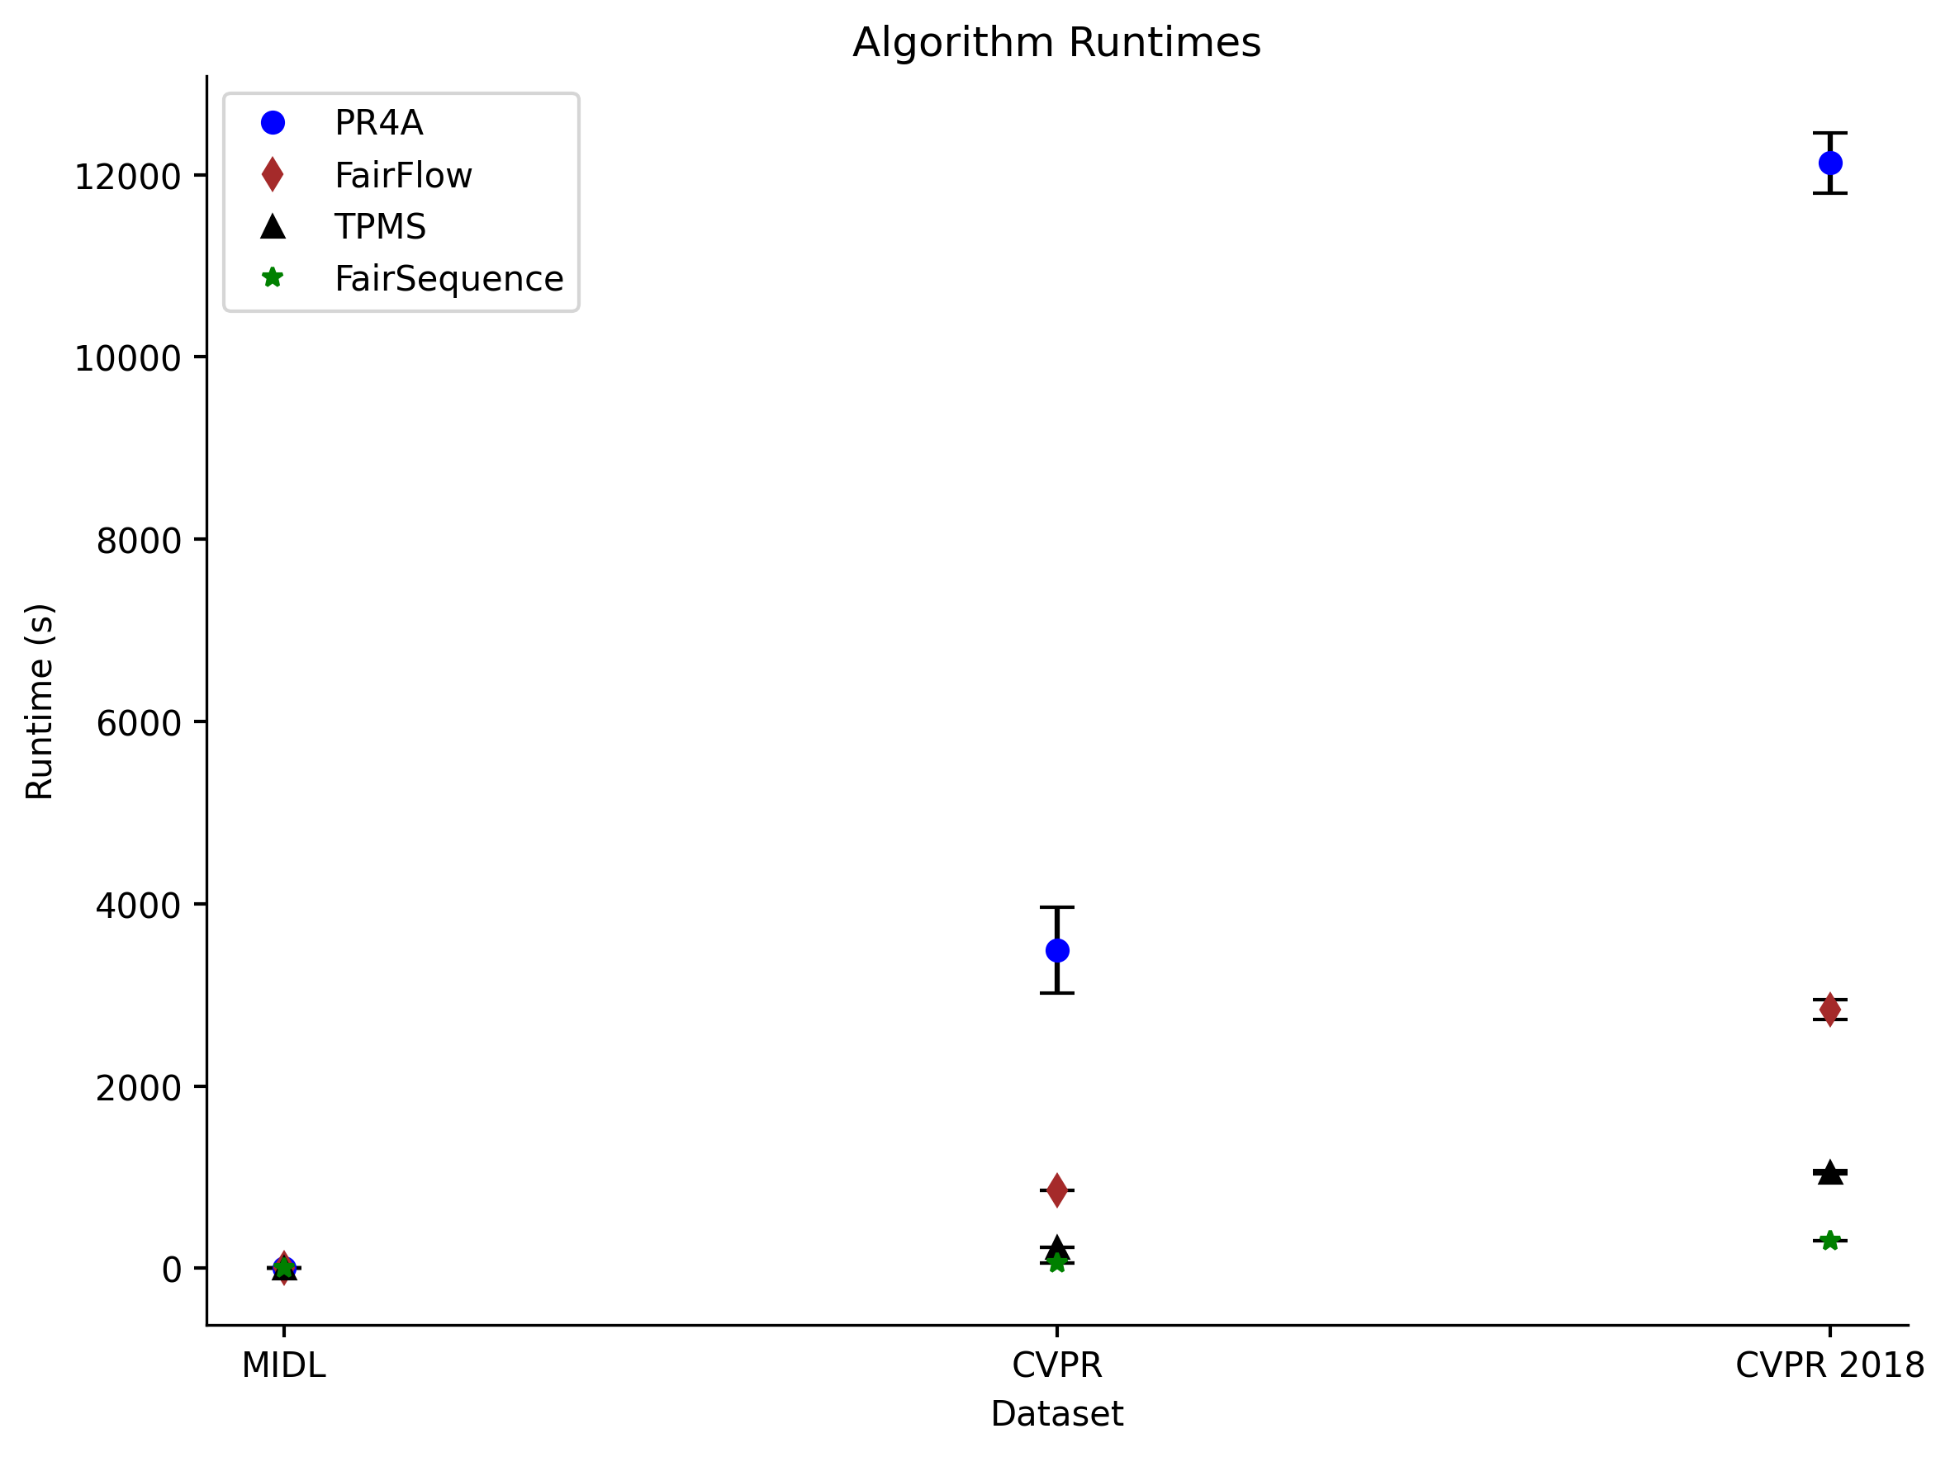
FairSequence – Very Fast!
~10x faster than FairFlow!
~3x faster than TPMS!

Slide 122
Welfare and Fairness
Our Approaches
TPMS (OPT) | FairFlow | PR4A | GRRR | FairSeq
$$100\%$$ | $$100\%$$ | $$98\%$$ | $$98\%$$ | $$99\%$$
$$0$$ | $$0$$ | $$0$$ | $$0$$ | $$0$$
MIDL
USW (% of OPT)
# EF$1$ Viol.
TPMS (OPT) | FairFlow | PR4A | GRRR | FairSeq
$$100\%$$ | $$96\%$$ | $$94\%$$ | $$88\%$$ | $$92\%$$
$$473545$$ | $$23344$$ | $$82$$ | $$0$$ | $$0$$
CVPR
USW (% of OPT)
# EF$1$ Viol.
TPMS (OPT) | FairFlow | PR4A | GRRR | FairSeq
$$100\%$$ | $$97\%$$ | $$97\%$$ | $$94\%$$ | $$96\%$$
$$134$$ | $$25$$ | $$2$$ | $$0$$ | $$0$$
USW (% of OPT)
CVPR ’18
# EF$1$ Viol.

Slide 123
FairSequence Fits the Criteria
Fairness
Ours are the only approaches that satisfy EF$1$
High USW w.r.t. TPMS (OPT) and algorithms used in practice
~10x speedup compared to fair competitors
Simplicity ➔ flexibility
Welfare
Speed
Flexibility

Slide 124
Look for FairSequence!
Available in

Slide 125
Can we trust affinity scores?
Reviewer bids
$$5$$
$$0$$
$$5$$
$$1$$
Given affinity scores
$$5$$
$$0$$
$$1$$
$$5$$
Keyword matching
$$0$$
$$0$$
$$3$$
$$0$$
$$2$$
$$3$$
$$5$$
$$4$$
$$5$$
$$4$$
$$8$$
$$4$$
Document-based scores
$$7$$
$$8$$
$$1$$
$$9$$
$$9$$
$$6$$
$$1$$
$$8$$
$$f$$
$$=$$
$$1$$
$$7$$
$$6$$
$$7$$
$$3$$
$$5$$
$$1$$
$$7$$
$$3$$
$$4$$
$$6$$
$$7$$
$$2$$
$$2$$
$$1$$
$$4$$
$$3$$
$$3$$
$$9$$
$$8$$

Slide 126
Can we trust affinity scores?
Reviewer bids
$$5$$
$$0$$
$$5$$
$$1$$
Given affinity scores
$$5$$
$$0$$
$$1$$
$$5$$
Keyword matching
$$0$$
$$0$$
$$3$$
$$0$$
$$2$$
$$3$$
$$5$$
$$4$$
$$5$$
$$4$$
$$8$$
$$4$$
Document-based scores
$$7$$
$$8$$
$$1$$
$$9$$
$$9$$
$$6$$
$$1$$
$$8$$
$$f$$
$$=$$
$$1$$
$$7$$
$$6$$
$$7$$
$$3$$
$$5$$
$$1$$
$$7$$
$$3$$
$$4$$
$$6$$
$$7$$
$$2$$
$$2$$
$$1$$
$$4$$
$$3$$
$$3$$
$$9$$
$$8$$

Slide 127
Can we trust affinity scores?
Reviewer bids
$$5$$
$$0$$
$$5$$
$$1$$
Given affinity scores
$$5$$
$$0$$
$$1$$
$$5$$
Keyword matching
$$0$$
$$0$$
$$3$$
$$0$$
$$2$$
$$3$$
$$5$$
$$4$$
$$5$$
$$4$$
$$8$$
$$4$$
Document-based scores
$$7$$
$$8$$
$$1$$
$$9$$
$$9$$
$$6$$
$$1$$
$$8$$
$$f$$
$$=$$
$$1$$
$$7$$
$$6$$
$$7$$
$$3$$
$$5$$
$$1$$
$$7$$
$$3$$
$$4$$
$$6$$
$$7$$
$$?$$
$$2$$
$$1$$
$$4$$
$$3$$
$$3$$
$$9$$
$$8$$

Slide 128
Can we trust affinity scores?
Reviewer bids
$$5$$
$$0$$
$$5$$
$$1$$
Model may introduce error
Given affinity scores
$$5$$
$$0$$
$$1$$
$$5$$
Scores may not always be available
Keyword matching
$$0$$
$$0$$
$$3$$
$$0$$
$$2$$
$$3$$
$$5$$
$$4$$
$$5$$
$$4$$
$$8$$
$$4$$
Document-based scores
$$7$$
$$8$$
$$1$$
$$9$$
$$9$$
$$6$$
$$1$$
$$8$$
$$f$$
TPMS scores were only available for ~60% of AAAI ’21 submissions!
$$=$$
$$1$$
$$7$$
$$6$$
$$7$$
$$3$$
$$5$$
$$1$$
$$7$$
$$3$$
$$4$$
$$6$$
$$7$$
$$?$$
$$2$$
$$1$$
$$4$$
$$3$$
$$3$$
$$9$$
$$8$$
Leyton-Brown et al. 22, Matching Papers and Reviewers at Large Conferences

Slide 129
Robust Reviewer Assignment
Feasible region $𝒮$ for affinity scores
Solution space $𝒜$ of valid assignments
$$A$$
$$𝒮$$
$$\max_{A∈𝒜}{\min_{S_{A}∈𝒮}{USW(A, S_{A})}}$$
$$S_{A}$$
Goals:
Find plausible models for $𝒮$ with simple solutions
Build general purpose robust optimization algorithm
Enable alternative welfare functions

Slide 130
$𝒮$ as Box Constraints
$$A$$
$$[4, 6]$$
$$…$$
$$𝒮$$
$$[7, 9]$$
$$[1, 5]$$
$$S_{A}$$

Slide 131
$𝒮$ as Box Constraints
$$[4, 6]$$
$$A$$
$$…$$
$$𝒮$$
$$[7, 9]$$
$$[1, 5]$$
$$S_{A}$$

Slide 132
$𝒮$ as Box Constraints
$$[4, 6]$$
$$A$$
$$…$$
$$𝒮$$
$$[7, 9]$$
$$[1, 5]$$
$$S_{A}$$
$$4$$
$$\max_{A∈𝒜}{\min_{S_{A}∈𝒮}{USW(A, S_{A})}}=\max_{A∈𝒜}{USW(A,\underline{S})}$$
$$\underline{S}=$$
$$7$$
$$…$$
$$1$$

Slide 133
$𝒮$ as Spherical Noise
$$ε=3$$
$$5$$
$$𝒮=ℬ_{ε}(S_{0})$$
$$S_{0}=$$
$$9$$
$$…$$
$$3$$

Slide 134
$𝒮$ as Spherical Noise
$$ε=3$$
$$5$$
$$𝒮=ℬ_{ε}(S_{0})$$
$$S_{0}=$$
$$9$$
$$…$$
$$3$$
Theorem:
$$\max_{A∈𝒜}{\min_{S_{A}∈ℬ_{ε}(S_{0})}{USW(A, S_{A})}}=\max_{A∈𝒜}{USW(A,S_{0})}$$
The welfare maximizer is robust to spherical noise.

Slide 135
$𝒮$ as Spherical Noise
Theorem:
$$\max_{A∈𝒜}{\min_{S_{A}∈ℬ_{ε}(S_{0})}{USW(A, S_{A})}}=\max_{A∈𝒜}{USW(A,S_{0})}$$
$$\min_{S_{A}∈ℬ_{ε}(S_{0})}{USW(A, S_{A})}=\min_{x∈ℬ_{ε}\left(0\right)}USW\left(A, S_{0}+x\right)$$
$$=USW\left(A, S_{0}\right)+\min_{x∈ℬ_{ε}\left(0\right)}USW\left(A, x\right)$$

Slide 136
$𝒮$ as Spherical Noise
Theorem:
$$\max_{A∈𝒜}{\min_{S_{A}∈ℬ_{ε}(S_{0})}{USW(A, S_{A})}}=\max_{A∈𝒜}{USW(A,S_{0})}$$
$$\min_{S_{A}∈ℬ_{ε}(S_{0})}{USW(A, S_{A})}=\min_{x∈ℬ_{ε}\left(0\right)}USW\left(A, S_{0}+x\right)$$
Minimized when $x$ points as far in the direction opposite $A$ as possible:
$$x=−A\frac{ε}{{\left|\left|A\right|\right|}_{2}}$$
$$=USW\left(A, S_{0}\right)+\min_{x∈ℬ_{ε}\left(0\right)}USW\left(A, x\right)$$

Slide 137
$𝒮$ as Spherical Noise
Theorem:
$$\max_{A∈𝒜}{\min_{S_{A}∈ℬ_{ε}(S_{0})}{USW(A, S_{A})}}=\max_{A∈𝒜}{USW(A,S_{0})}$$
$$\min_{S_{A}∈ℬ_{ε}(S_{0})}{USW(A, S_{A})}=\min_{x∈ℬ_{ε}\left(0\right)}USW\left(A, S_{0}+x\right)$$
Minimized when $x$ points as far in the direction opposite $A$ as possible:
$$x=−A\frac{ε}{{\left|\left|A\right|\right|}_{2}}$$
$$=USW\left(A, S_{0}\right)+\min_{x∈ℬ_{ε}\left(0\right)}USW\left(A, x\right)$$
$$=USW\left(A, S_{0}\right)+USW\left(A, −A\frac{ε}{{\left|\left|A\right|\right|}_{2}}\right)$$
$$=USW\left(A, S_{0}\right)−{\left|\left|A\right|\right|}_{2}^{2}\frac{ε}{{\left|\left|A\right|\right|}_{2}}$$
$$=USW\left(A, S_{0}\right)−{\left|\left|A\right|\right|}_{2}^{}ε$$
Constant, due to constraints

Slide 138
AAAI’s Affinity Scores
Noise varies by score availability
Also modeled by elliptical noise

Slide 139
AAAI’s Affinity Scores
Noise varies by score availability
Also modeled by elliptical noise

Slide 140
(Groupwise) Egalitarian Welfare
$$ESW\left(A, S\right)= \min_{i∈N}{\sum_{j∈R}{A_{ij}S_{ij}}}$$
If we have groups $G=\{G_{1}, G_{2}…G_{g}\}$
(e.g. subject areas/tracks),
we define groupwise ESW:
$$ESW\left(A, S, G\right)= \min_{G_{k}∈G}{\sum_{i∈G_{k}}{\sum_{j∈R}{A_{ij}S_{ij}}}}$$

Slide 141
(Groupwise) Egalitarian Welfare
$$ESW\left(A, S\right)= \min_{i∈N}{\sum_{j∈R}{A_{ij}S_{ij}}}$$
Fair to papers
If we have groups $G=\{G_{1}, G_{2}…G_{g}\}$
(e.g. subject areas/tracks),
we define groupwise ESW:
$$ESW\left(A, S, G\right)= \min_{G_{k}∈G}{\sum_{i∈G_{k}}{\sum_{j∈R}{A_{ij}S_{ij}}}}$$
Fair to subject areas

Slide 142
Future Work
Quantify integrality gaps
What is the impact of rounding?
Closed-form solution for elliptical noise?
More realistic experimental setup
Build document-similarity and bidding models with noise estimates
Robust fairness
Envy term in the objective
Group-wise egalitarian welfare
Other applications of robust allocation
Course allocation with inferred preferences, etc

Slide 143
Measuring Robustness
Identify allocation $A_{S_{0}}$ produced by solving for optimal under $S_{0}$
Concentrate noise around pairs assigned by $A_{S_{0}}$ with parameter $1−α$
Compare worst-case and random-case welfare of $A_{S_{0}}$ with robust solution $A_{R}$
$$A_{R}$$
$$4$$
$$A_{S_{0}}$$
$$𝒮$$
Random case
Worst case for $A_{S_{0}}$
Worst case for $A_{R}$

Slide 144
Compute affinity scores
Maximize function of affinity scores
Collect constraints
Collect data
Adjust assignment
Predictive model based on historical performance

Slide 145
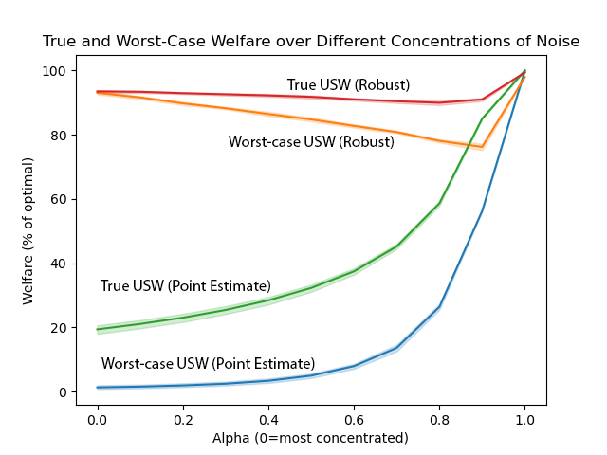
Measuring Robustness
Robust achieves higher
worst-case USW
and higher USW on randomly
sampled true scores
$α$ controls concentration
of noise on pairs assigned
by point estimate method

Slide 146
Computing the Subgradient
Initialize $A_{1}=\max_{A∈𝒜}{USW(A,S_{0})}$
For $t∈\left\{1, 2,…T\right\}:$
$S_{t}=\underset{S∈𝒮}{argmin}{USW(A_{t},S)}$
$A_{t+1}=A_{t}+\frac{1}{t+1}S_{t}$
$A_{t+1}=P_{𝒜}(A_{t+1})$
Return rounded $A_{T}$
Projection onto feasible set of allocations $𝒜$
Round to an integer, constraint-satisfying allocation¹
1. Jecmen et al., NeurIPS 2020.

